Slide 1
One High Ranking Automatic Traceability Paper Review
Replace the below text with corresponding heading of your meeting discussion
Your Name

Slide 2
Recap Last Meetings Outcome
In this slide, list down what you discussed with Dr Yulei and co-supervisor last week and explained what actions did you take to address the issues.
Colour the line with Red, if any urgent action need to discuss.
Review paper from last presentation is too old, need to find recent contributions
Find 3 or 4 High Rank Papers and synthesize the following
Problem Address
Architecture
Gap/Weakness
Any Follow Up/Waiting/Proceed from Supervisors Mentioned in here

Slide 3
Review Paper Details
In the below table, filled in the list of papers, which you would like to discuss in the meeting
Tile | Author | Year | Conference | Rank | Paper Access Link
Paper 1 Title |  |  | ICSME | A
Conference Ranking can check in this link
http://portal.core.edu.au/conf-ranks/?search=0803&by=for&source=all&sort=arank&page=1
I included one review paper in the following slides to give you an idea of how I normally
present the findings in the meeting. It is an example, feel free to modify with your own format ☺

Slide 4
Automatic Traceability Maintenance via Machine Learning Classification (Problem Address)
Paper proposes a framework call TRAIL (TRAceability Links Classifiers) to automatically verify the potential trace links (e.g, valid, invalid) , which are generated with 7 Information Retrieval (IR) techniques (VSM, LSA,LDA, JS, OkapiBM25,LM, JM)
In standard IR-based traceability process, an analyst need to manually review the potential trace link results generated with IR techniques and verify the validity.
In this paper, it provides a framework to learn pattern of pre-existing traceability links to train multiple machine learning classifier model to predict the validity of the trace links.

Slide 5

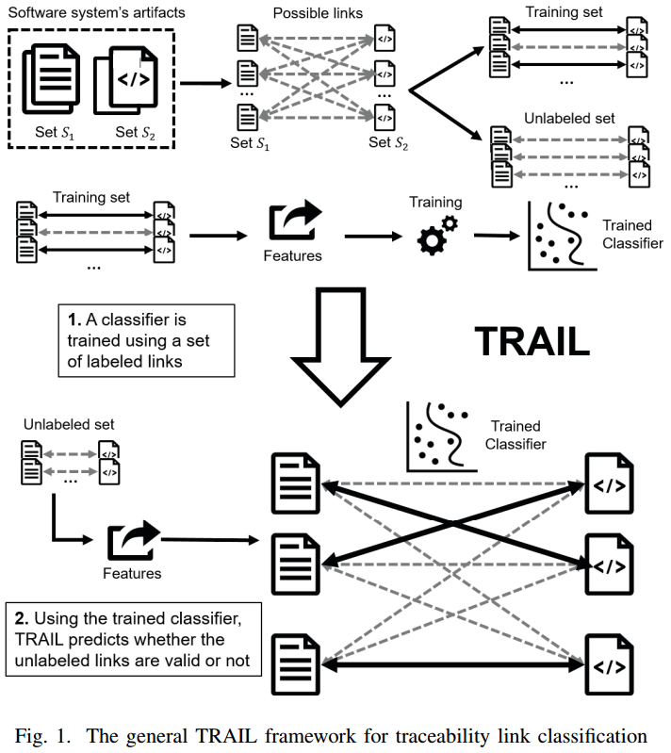
Automatic Traceability Maintenance via Machine Learning Classification (Architecture)
TRAIL Four Components
Define Feature Lists (131 Features ) - IR similarity scores ( VSM, LSA, LDA, JS, OkapiBM25,LM, JM) - Query Quality Metric (28 metrics) - Document Statistics Features (no of unique of term in the document, total no of terms in the document, percentages of overlapping the terms in two documents)
Feature Selection Correlation Correlation Based Feature Selection (CFS) GainRatio InfoGain Symmetrical uncertainty
Data Balancing 5050 Undersampling SMOTE
Machine Learning Classifiers Random Forest kNN (k= 5) Multinomial logistic regression model NativeBayes Support Vector Model Voted

Slide 6
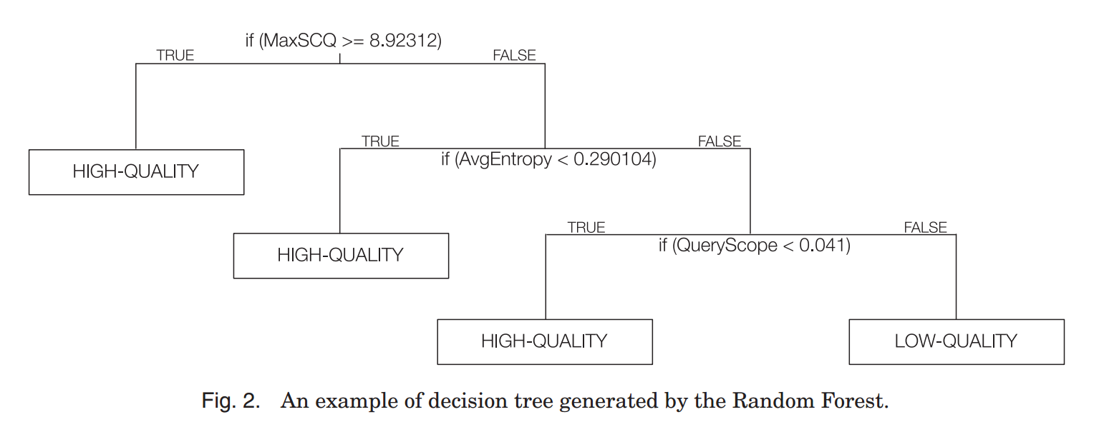
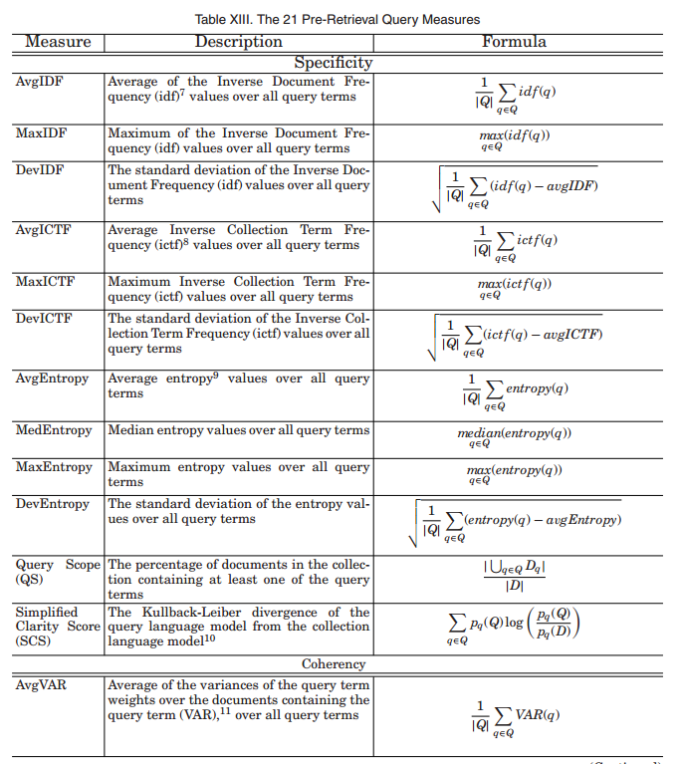
Automatic Traceability Maintenance via Machine Learning Classification (Architecture)
Query Quality Metrics (28)
Paper : Predicting Query Quality for Applications of Text Retrieval to Software Engineering Tasks https://dl.acm.org/citation.cfm?id=3078841

Slide 7
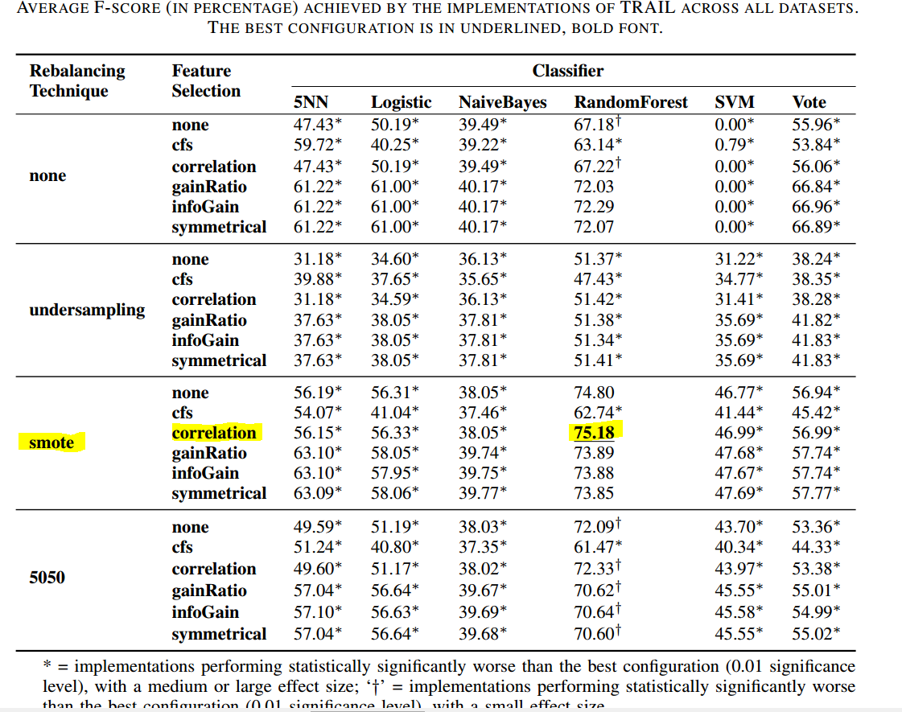
Automatic Traceability Maintenance via Machine Learning Classification (Architecture)

Slide 8
Automatic Traceability Maintenance via Machine Learning Classification (Gap/Weakness)
Core IR trace recovery problem vocabulary mismatch problem is still remaining in this framework.
Result are imprecise (can include high false positive links, low precision )
Understanding semantic relations between terms are not covered in this framework

